Slide 1
SMARTROOT VIRTUAL FARM HUB (IO3)

Slide 2
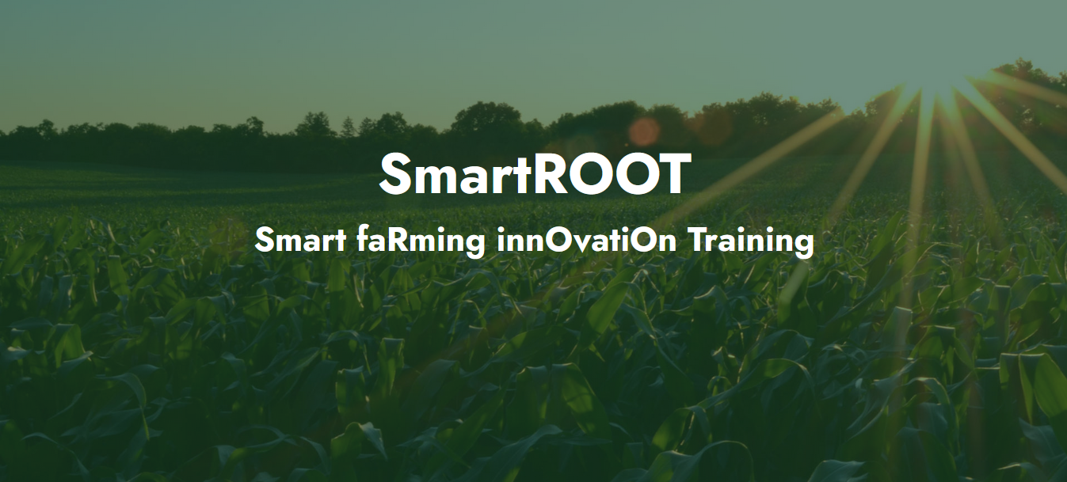
SMARTROOT VIRTUAL FARM HUB (IO3)
The platform
https://virtualfarm.infalia.com/

Slide 3
SMARTROOT VIRTUAL FARM HUB (IO3)
The platform consists of 5 tools:
An e-Class platform
A Farm Management tool
A Data Visualization tool
A tool for web-based geospatial catalogue explorers
The Farmer educational game

Slide 4
SMARTROOT VIRTUAL FARM HUB (IO3)
e-Class platform
The e-Class platform is acting as an open hub for knowledge accumulation with the enrollment of agriculturist, veterinaries, computer engineers, as well as agriculture stakeholders such as farmers and breeders.

Slide 5
SMARTROOT VIRTUAL FARM HUB (IO3)
Farm Management
A web-based application representing a virtual farm where data from mixed farming activities will be presented for educational purposes. The environment will offer different levels of configuration creating an interactive teaching environment.

Slide 6
SMARTROOT VIRTUAL FARM HUB (IO3)
Data Visualization
Visualize your data and do anything from tracking query load to understanding the way requests flow through your apps.

Slide 7
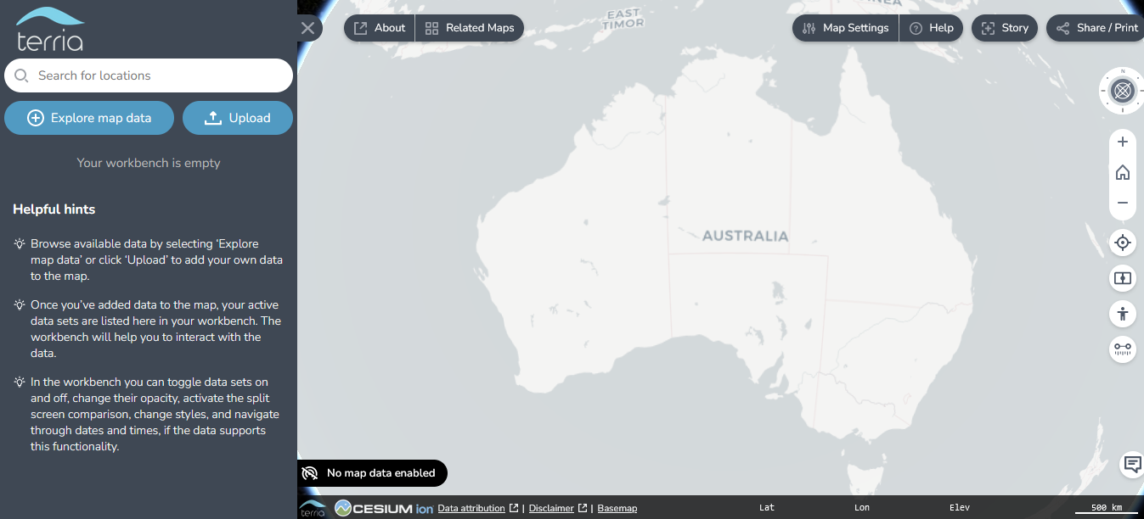
SMARTROOT VIRTUAL FARM HUB (IO3)
Tool for web-based geospatial catalogue explorers
A feature rich open source solution for building amazing spatial data federation web platforms.

Slide 8
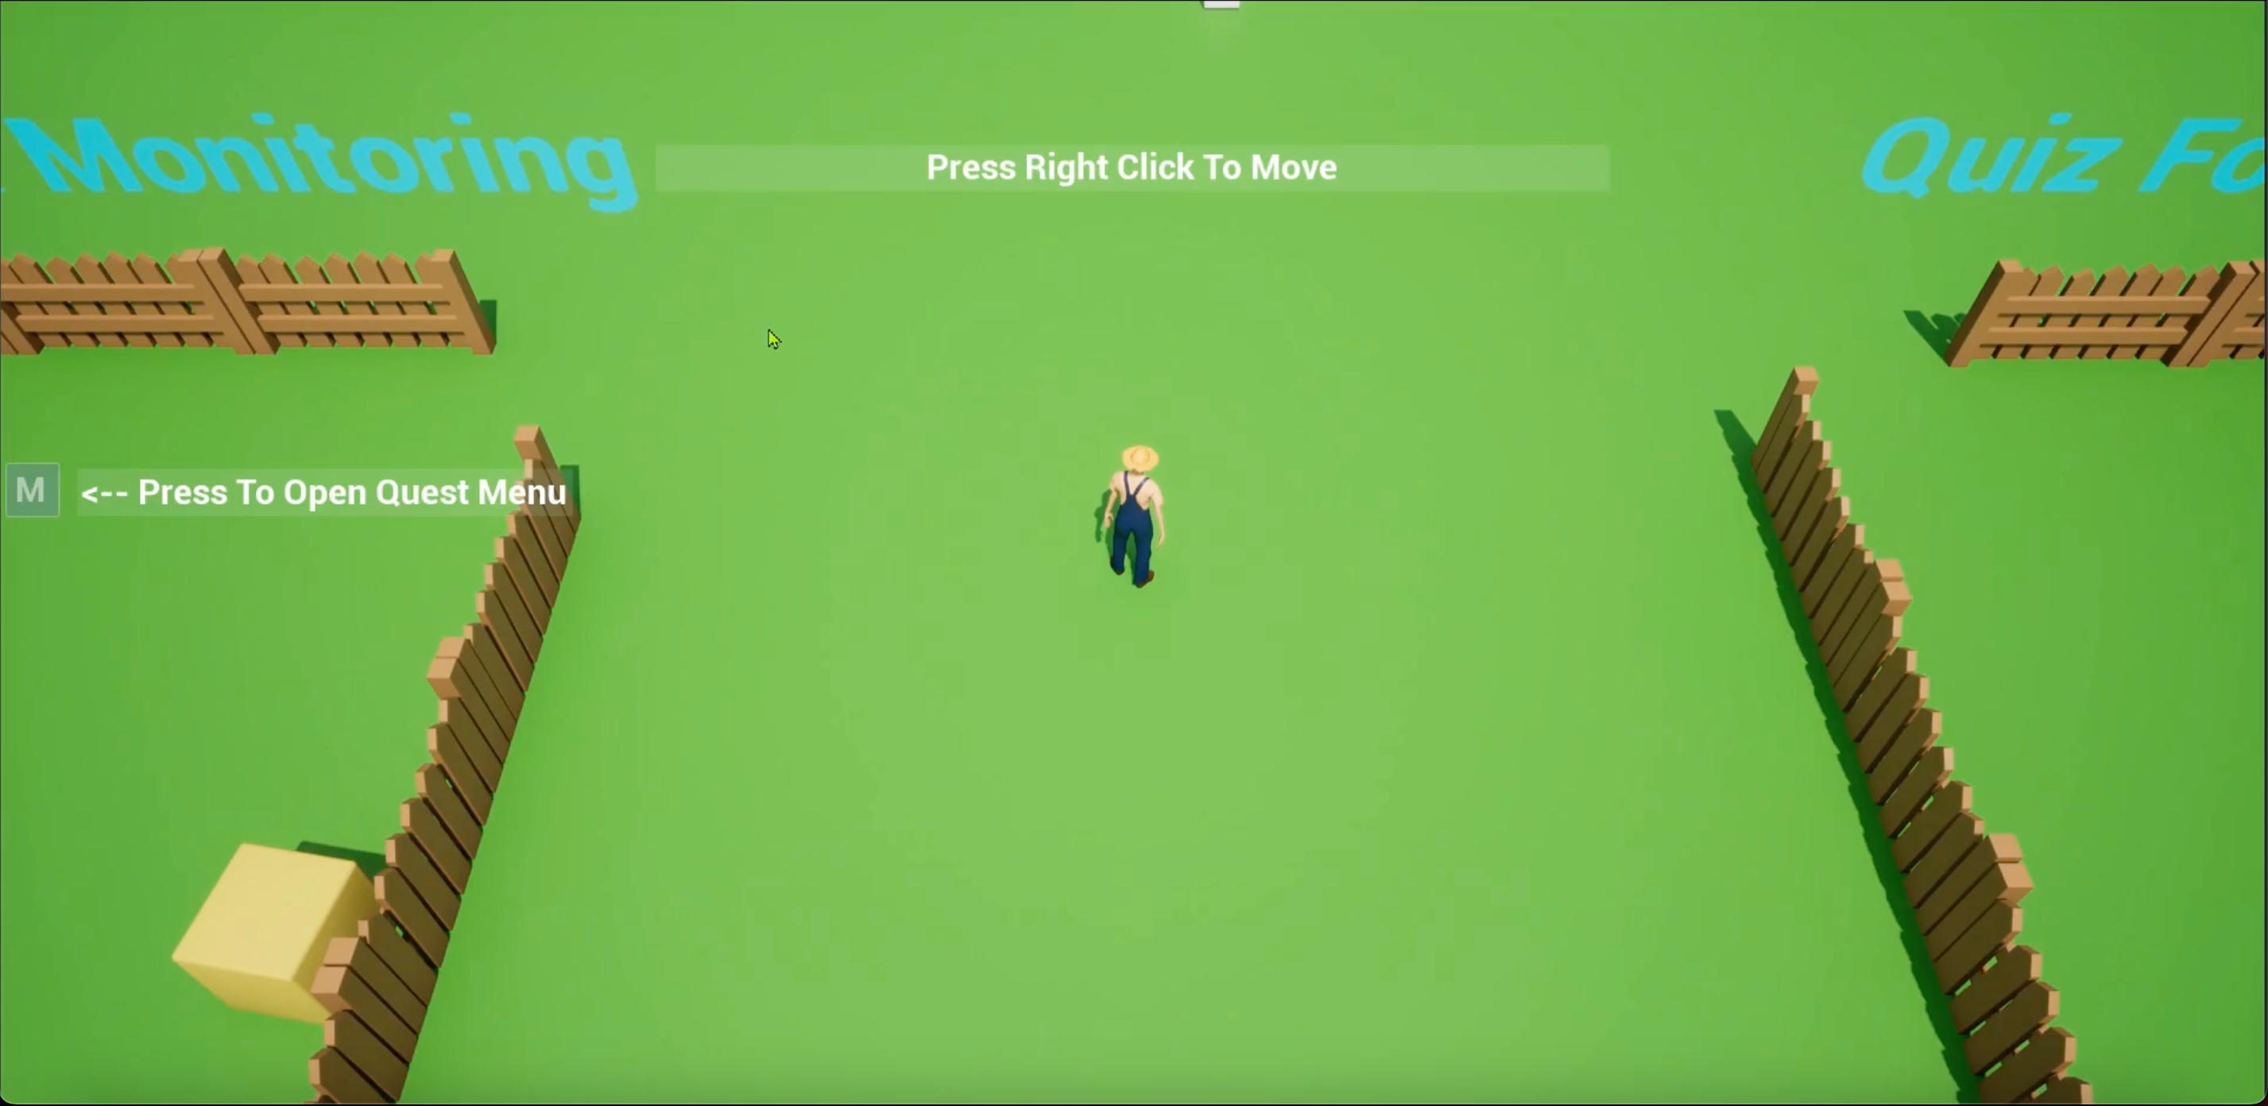
SMARTROOT VIRTUAL FARM HUB (IO3)
The farmer educational game
Solve small puzzles and enhance your knowledge using your farmer hero.

